Slide 1

PANIMALAR ENGINEERING COLLEGE
Department of Mechanical Engineering
FINAL YEAR
PROJECT ON
JUTE / POLYESTER HYBRID COMPOSITE
Presented by:
S.V. Ragul (211420114084)
S. Munishwaran (211420114070)
E. Raghul (211420114082)
V. Motheesh (211420114068)
Under the Guidance of:
MR. J. MURUGESAN, ME., (PhD).,
Assistant Professor
Department of Mechanical Engineering

Slide 2
PANIMALAR ENGINEERING COLLEGE
A Project on Jute/Polyester Hybrid Composite
Introduction:
The idea of combining two or more materials resulting in a new material with improved
property exist for ages.
A composite material is a material system composed of a mixture or combination
of two or more micro or macro constituents that differ in form an chemical
composition and which are essentially insoluble in each other.
The two main components in a composite material are the fiber phase and matrix
Phase, the fiber phase is responsible for the stiffness and strength of the material and
The matrix phase is responsible for the binding and dimensional stability of the material
Page 2 of 20

Slide 3
PANIMALAR ENGINEERING COLLEGE
A Project on Jute/Polyester Hybrid Composite
Abstract:
Experimental investigation of hybrid composites are performed to study the mechanical
property using flexural testing and to study the strength of Stitched Jute/polyester
Composite and Unstitched laminated composite when subjected to flexural loading.
The sample is drilled at the centre and the stitch diameter around the hole is varied,
Viz. 7mm around the hole to13 mm around the hole. flexural test is conducted to find
strength of the specimens.
Also the various stacking sequences of the laminate plies are found and the strength is
compared with the pre found stitched specimens.
While comparing the strength of specimen having maximum number of stitches around the
hole with the strength obtained in specimens with varying stacking sequence, it is observed
that its strength is approximately equal to specimen with one layer of polyester at each
extreme end (S2).
Page 3 of 20

Slide 4
PANIMALAR ENGINEERING COLLEGE
A Project on Jute/Polyester Hybrid Composite
METHODOLOGY:
Natural fiber specimen with circular holes
Designing
Natural and composite material with stitches around the holes
Fabrication
Testing
Testing in UTM machine
Comparison
Comparison of stacking sequence And stitching
Plot the results
Page 4 of 20

Slide 5
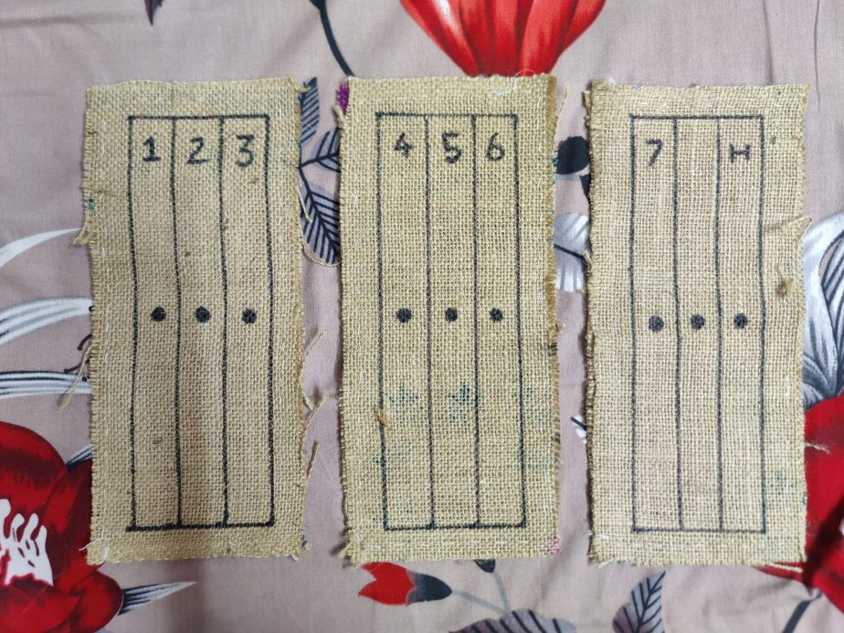
PANIMALAR ENGINEERING COLLEGE
A Project on Jute/Polyester Hybrid Composite
FIBER PREPARATION:
FIBRE: Woven Jute (Mat Form)
Jute fiber is used for fabricate the natural fiber composites.
The natural fibers are cut in the length of 300 mm, 125 mm
and 3 mm by scissor and sides of the jute were stitched to make
a pair, like wise 3 pairs are made.
The jute fiber is divided into three parts and various numbers are
marked then center of the divided part is marked with 6mm circle.
The Stitches are made around the marked circle accordingly.
Page 5 of 20

Slide 6



PANIMALAR ENGINEERING COLLEGE
A Project on Jute/Polyester Hybrid Composite
LOCALIZED HYBRIDIZATION:
the localised hybridisation process is carried out by stitching around the hole. There are nine specimens in which one is complete natural and another one is full polyester layer fitted inside the layers.
The specimens are
Natural – fully jute with no stitch
S1 – 1 stitch around the hole of diameter 7mm
S2 - 2 stitch around the hole of diameter 8mm
S3 – 3 stitch around the hole of diameter 9mm
S4 – 4 stitch around the hole of diameter 10mm
S5 – 5 stitch around the hole of diameter 11mm
S6 – 6 stitch around the hole of diameter 12mm
S7 – 7 stitch around the hole of diameter 13mm
Polyester – polyester fibre placed between two natural fibres
Page 6 of 20

Slide 7
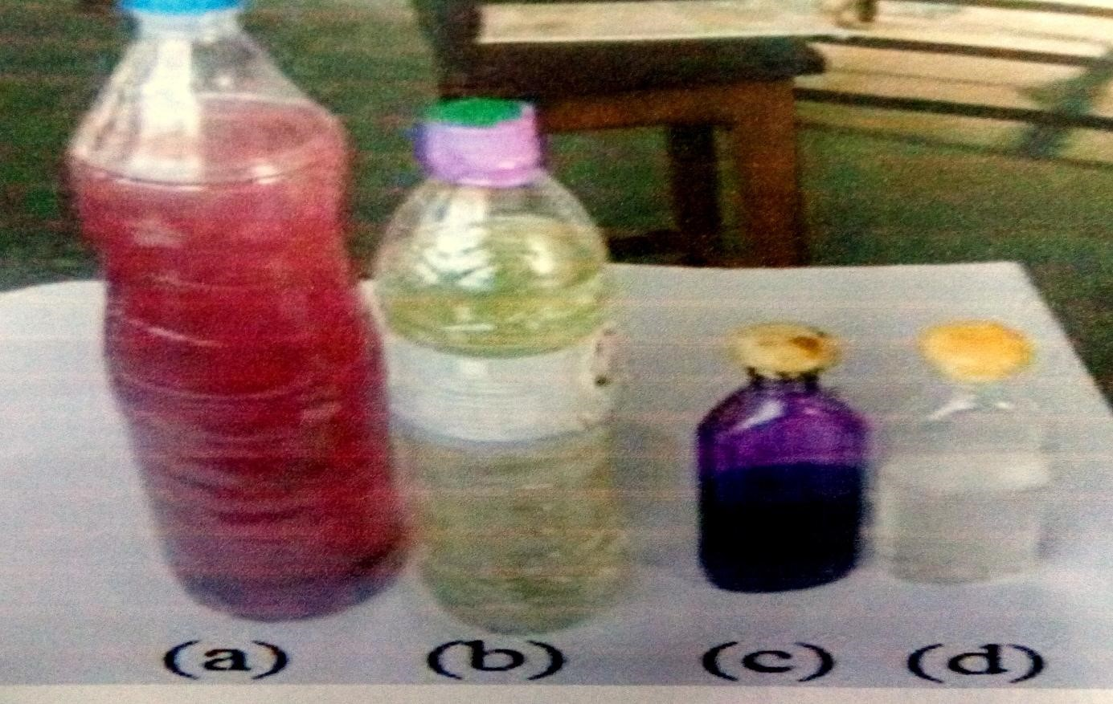
PANIMALAR ENGINEERING COLLEGE
A Project on Jute/Polyester Hybrid Composite
MATRIX PREPARATION:
MATRIX: Unsaturated Polyester
(a) Mixture of Resin, Catalysts and Hardener
(b) Resin: Unsaturated polyester resin
(c) Catalyst: methyl ethyl ketone peroxide
(d) Hardener: Cobalt Napthanate
Resin - 97.5 % of Unsaturated polyester resin
Hardener - 0.5 % of Cobalt Napthanate
Catalyst -2 % of Methyl Ethyl Ketone Peroxide(MEKP)
Page 7 of 20

Slide 8
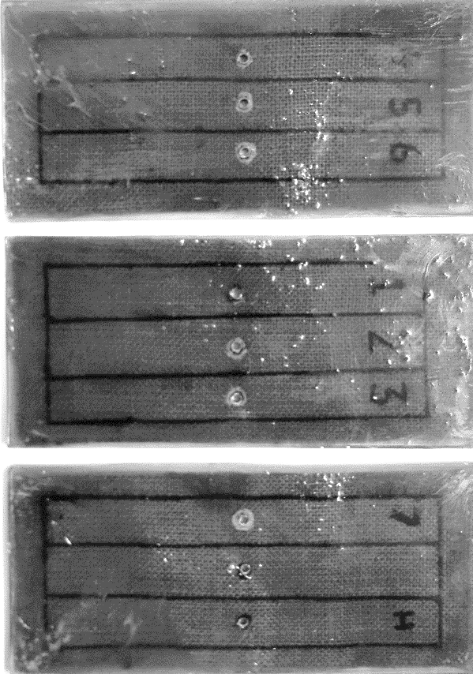
PANIMALAR ENGINEERING COLLEGE
A Project on Jute/Polyester Hybrid Composite
HYBRID COMPOSITE MAKING :
Various no. of stitches are sewed around the center mark on the jute
composite.
The matrix mixture is prepared according to the ratio of the resin,
hardener, and catalyst.
The mould is prepared in mild steel with 300 mm × 125 mm × 8 mm
dimensions in 3 parts namely base plate, frame and lid.
The matrix solution is poured into the mould and the fiber composite
is dipped in it.
The lid is closed and the mould is kept under constant pressure for
48hrs then the hybrid composite is ready for testing.
Page 8 of 20

Slide 9
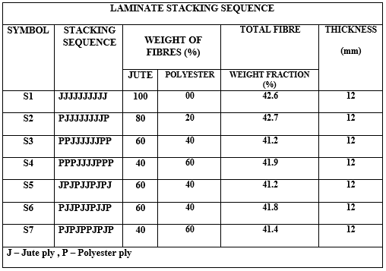
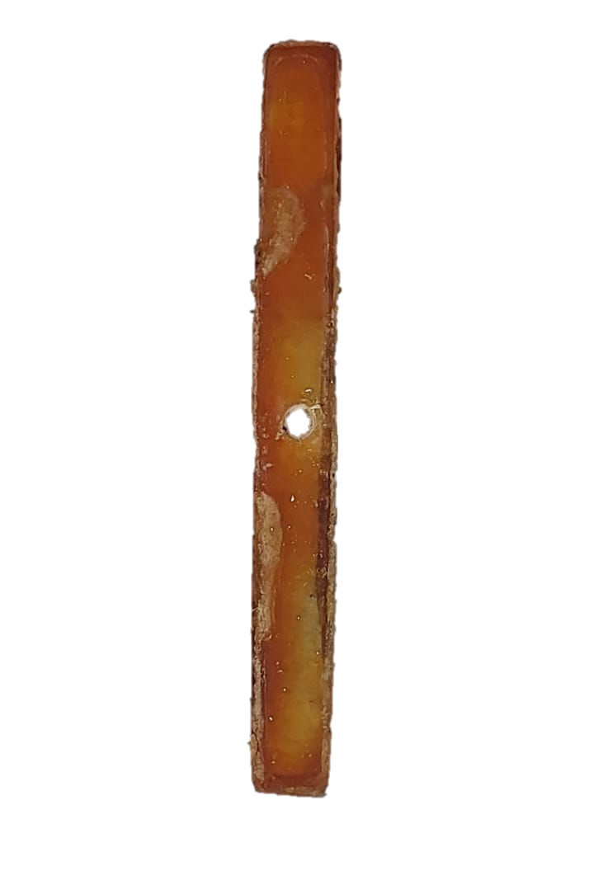
PANIMALAR ENGINEERING COLLEGE
A Project on Jute/Polyester Hybrid Composite
UNSTITCHED LAMINATE COMPOSITE:
The specimens were manufactured by manual lay-up technique in a mould and preserved under light low pressure for 1h, and it is preserved for 48h at room temperature.
All the specimens consists a total of 10 plies, by varying the quantity and location of polyester plies so as to obtain seven different combination of plies with
125mm length and 10mm width.
The matrix mixing process is the same as hybrid composite making process, and the center of each sample is marked with 6mm circle.
Page 9 of 20

Slide 10
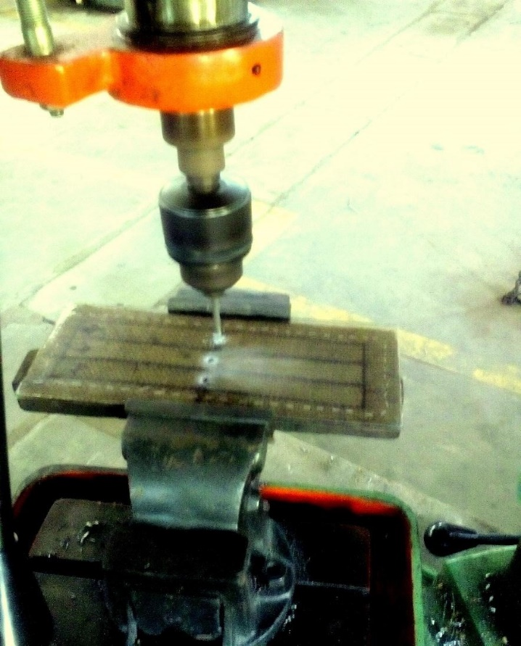
PANIMALAR ENGINEERING COLLEGE
A Project on Jute/Polyester Hybrid Composite
DRILLING OF THE COMPOSITE
The composite is kept in the bed of a drilling machine
and is fixed on all the sides.
6mm drill bit is attached to the chuck of the drilling
machine.
The composite is drilled in three parts until it reaches
the other side.
This process is repeated with all the 3 pairs of the stitched
composite and the unstitched laminate composites.
Page 10 of 20

Slide 11
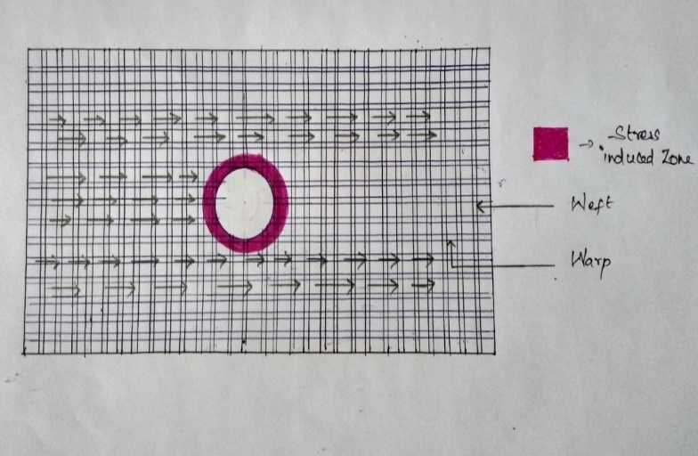
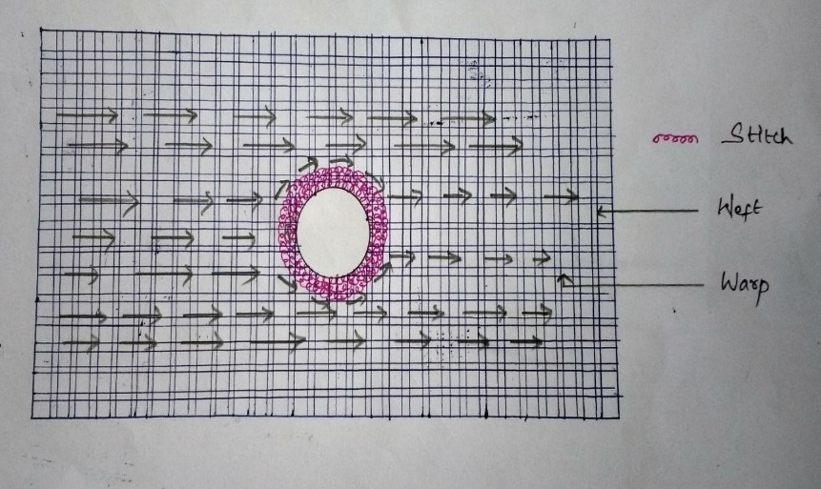
PANIMALAR ENGINEERING COLLEGE
A Project on Jute/Polyester Hybrid Composite
STRESS CONCENTRATION:
Fig.7.1 – Schematic diagram of specimen before stitching
Fig.7.2 – Schematic diagram of specimen after stitching
The figure 7.1 shows the stress induced zone around the hole in the composite.
The fiber along the horizontal direction of woven jute specimen is called as WARP. It is the load carrying element.
The fiber along the vertical direction of woven jute specimen is called as WEFT. It is the load distributing element.
Due to the breakage in the load transmission path in the specimen, the load cannot be transmitted to other end.so, the stress concentration is induced around the hole.
The figure 7.2 shows the stitch is made around the hole to form a bridge for transmitting the load to other end.
The stitch neglects the breakage and reduces the stress greatly.
It is done by distributing the stress through stitch.
Page 11 of 20

Slide 12
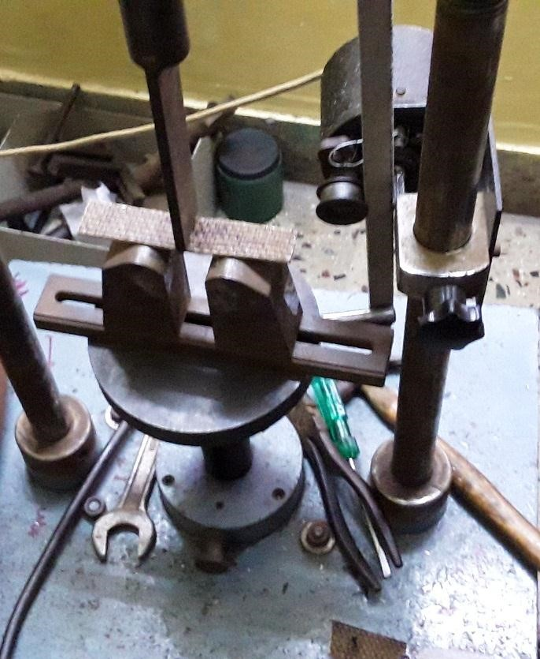
PANIMALAR ENGINEERING COLLEGE
A Project on Jute/Polyester Hybrid Composite
FLEXURAL TESTING:
The ASTM D 790 standard is used for conducting the flexural
test.
Specimens of 125mm length and 10mm wide were separated from the laminate so that the jute warp yarns are directed towards the length of the specimen.
Specimens were loaded under three point restricted
bending.
The machine induces point load at he center of the specimen to find the flexural strength and the displacement.
This process is repeated for the stitched hybrid composite and the unstitched laminate composite.
The corresponding values are noted and the graphs, tables are attained for comparison
Page 12 of 20

Slide 13
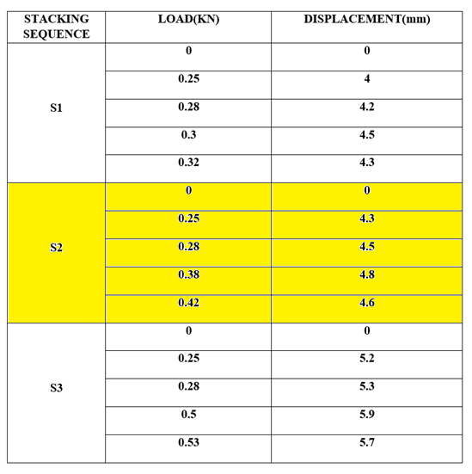
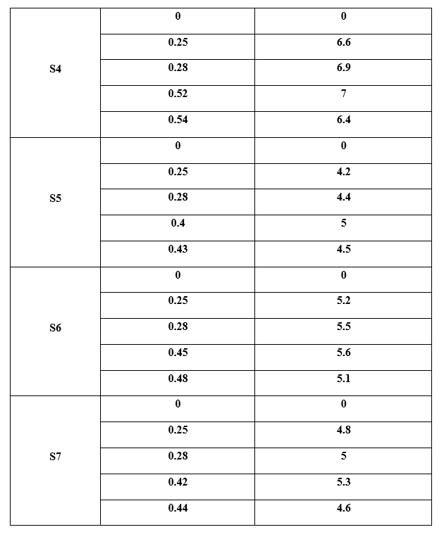
PANIMALAR ENGINEERING COLLEGE
A Project on Jute/Polyester Hybrid Composite
OBSERVATIONS OF SPECIMEN WITH VARIOUS STACKING SEQUENCE
Page 13 of 20

Slide 14
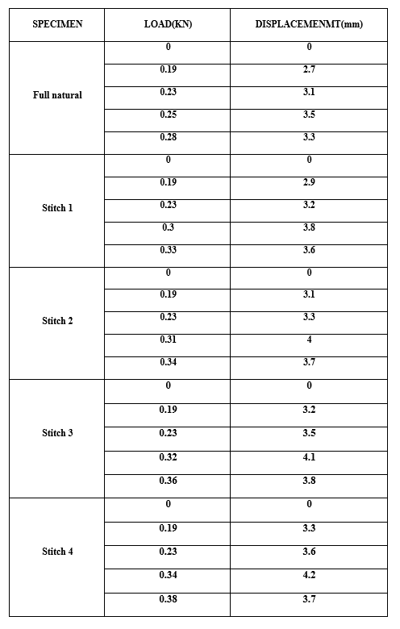
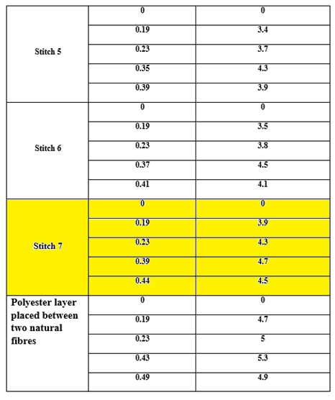
PANIMALAR ENGINEERING COLLEGE
A Project on Jute/Polyester Hybrid Composite
OBSERVATIONS OF SPECIMEN WITH VARYING NUMBER OF STICHES
Page 14 of 20

Slide 15
PANIMALAR ENGINEERING COLLEGE
A Project on Jute/Polyester Hybrid Composite
OBSERVATION:
Load vs displacement of
Stacking sequence table
Load vs displacement of
Stitched specimen table
STACKING SEQUENCE | LOAD(KN) | DISPLACEMENT(mm)
S2 | 0 | 0
 | 0.25 | 4.3
 | 0.28 | 4.5
 | 0.38 | 4.8
 | 0.32 | 4.6
SPECIMEN | LOAD(KN) | DISPLACEMENMT(mm)
Stitch 7 | 0 | 0
 | 0.19 | 3.9
 | 0.23 | 4.3
 | 0.25 | 4.7
 | 0.28 | 4.5
Page 15 of 20

Slide 16
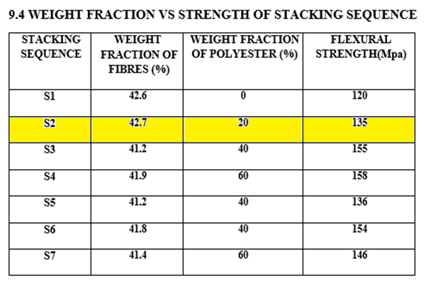
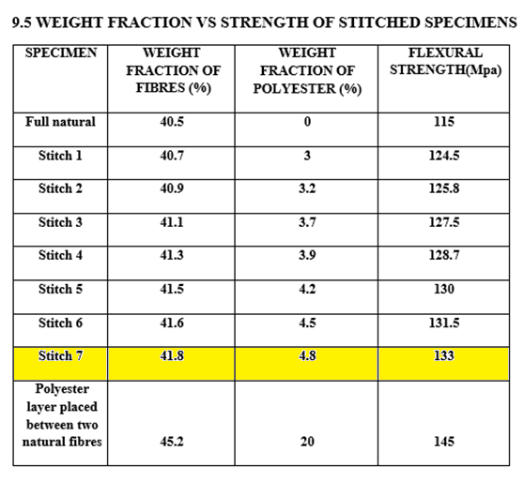
PANIMALAR ENGINEERING COLLEGE
A Project on Jute/Polyester Hybrid Composite
OBSERVATION:
Page 16 of 20

Slide 17
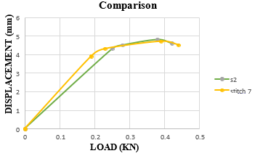
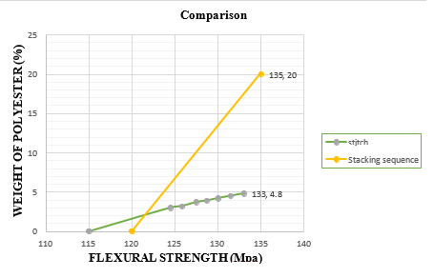
PANIMALAR ENGINEERING COLLEGE
A Project on Jute/Polyester Hybrid Composite
COMPARISON:
Page 17 of 20

Slide 18
PANIMALAR ENGINEERING COLLEGE
A Project on Jute/Polyester Hybrid Composite
Difference Between
Stitched Composite and Unstitched Laminated Composite
Stitched Composite | Unstitched Laminated Composite
Can be made within 8mm Thickness. Cost of the materials are Cheap thus the Cost of the final Product is also Cheaper. The Weight of the Stitched Composite is Lighter When compared to the Unstitched Laminated Composite. Need Information of the Holes before manufacturing for the usage of the Material. | Need at least 12mm thickness to withstand the load matching the Stitched Composite. Cost of the materials are high thus the Cost of the final product is costly. Weight of the Unstitched Laminated Composite is heavier than the Stitched Composite. Does not Need Pre determined holes for the Usage of the Material.
Page 18 of 20

Slide 19
PANIMALAR ENGINEERING COLLEGE
A Project on Jute/Polyester Hybrid Composite
Conclusion:
The strength of the specimens of various stacking sequence is tested for the comparison of the same with the stitched one.
From all our observations we came to know that the localized hybridized material is nearly equal to the fully hybridized material.
Finally from our observations we came to know that the strength of the seventh stitch is approximately equal to the stacking sequence 2.
Hence it is proved that the composite with localized hybridization technique having synthetic fiber content of 4.8% has equal strength to the composite having synthetic fiber content of 20%.
Page 19 of 20

Slide 20

PANIMALAR ENGINEERING COLLEGE
A Project on Jute/Polyester Hybrid Composite
Page 20 of 20

